Slide 1

What is a user story?
Martin Schray

Slide 2
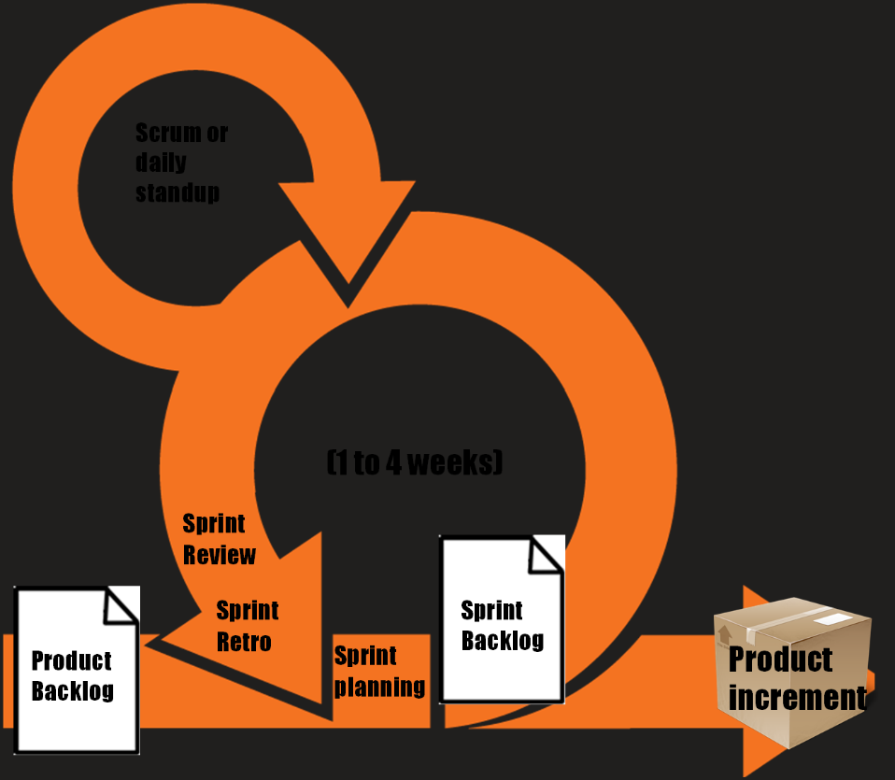
Scrum Ceremonies
The product backlog and spring backlog contain user stories

Slide 3
What is a user story for this class?
A unit of work (chunk of work) to be done – no more work than can be done during/between this class and the next
Done by an individual
Should provide details so I know when I am done (called definition of done or acceptance criterion).
What “tasks” or items need to be complete for this to done?
Example
Complete Product Design Doc
every section of the product design doc is complete with relevant and appropriate content
Product design doc is approved by faculty member

Slide 4
What is a user story (real world)?
A mechanism for capturing user requirements - while allow allowing just in time detail to be added
Is supposed to have just enough detail
Stories are stored in the Product backlog
Stories to be done in this sprint are called "sprint backlog"
its called part of the sprint product backlog
Usually just marked with tag to indicate its in the current sprint (or are in a specific column)
Stories near the "top" of the product backlog (most ready to be used in the next sprint or two) have more details

Slide 5
Story components
Card - the card itself (physical or in software tool)
Conversation (e.g. the story doesn't have exhaustive detail it will likely require conversation to get to the right level of details)
Confirmation - acceptance criteria (so when the developer knows when it’s done)

Slide 6
User Story Format
As a (who wants to accomplish something)
I want to (what they want to accomplish)
So that (why they want to accomplish that thing)

Slide 7
Example story
As a bank customer
I want to see my account balance
So that I know how much I have to spend on bills

Slide 8
Good stories should INVEST
INVEST criterion for stories - What does INVEST Stand For? | Agile Alliance (agilealliance.org)
A good user story should be:
“I” ndependent (of all others)
“N” egotiable (not a specific contract for features)
“V” aluable (or vertical)
“E” stimable (to a good approximation)
“S” mall (so as to fit within an iteration)
“T” estable (in principle, even if there isn’t a test for it yet)

Slide 9
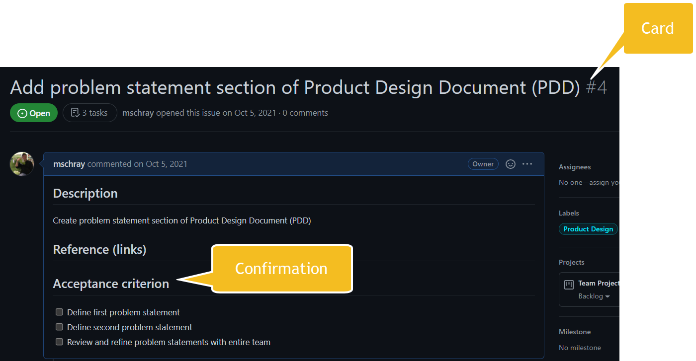

Slide 10
